Slide 1
GBIC2 – Realising the vision
Donald Hobern, GBIF Executive Secretary
Macropus robustus Gould, 1841, subspecies erubescens, Euro, Denham, WA, Australia, 10 January 2018

Slide 2
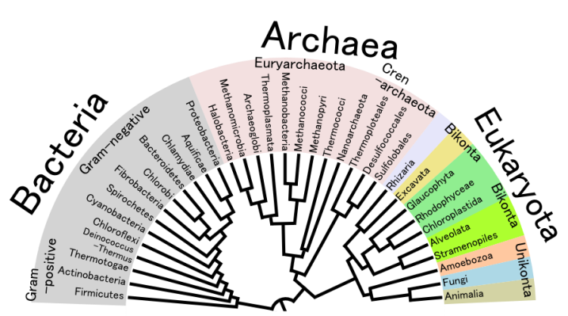
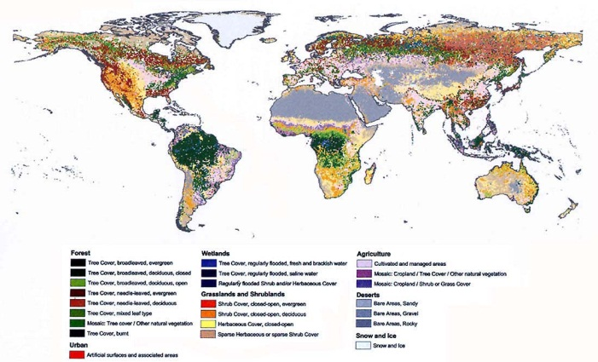
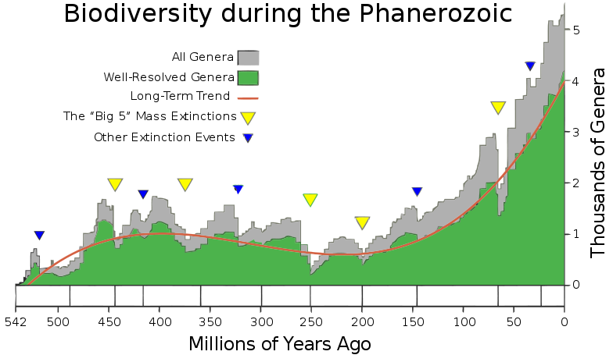
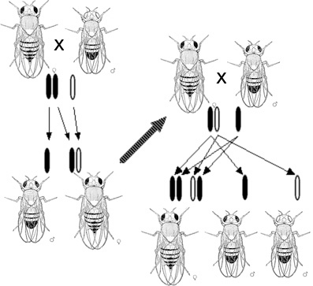
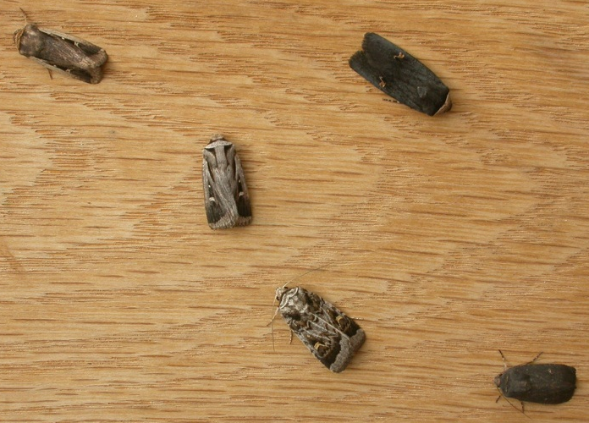
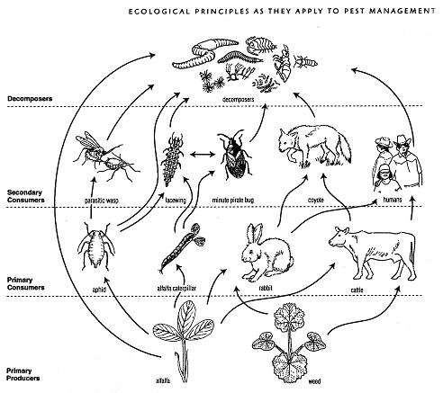
Complexity of biodiversity

Slide 3

Global Cooperation Matters

Slide 4






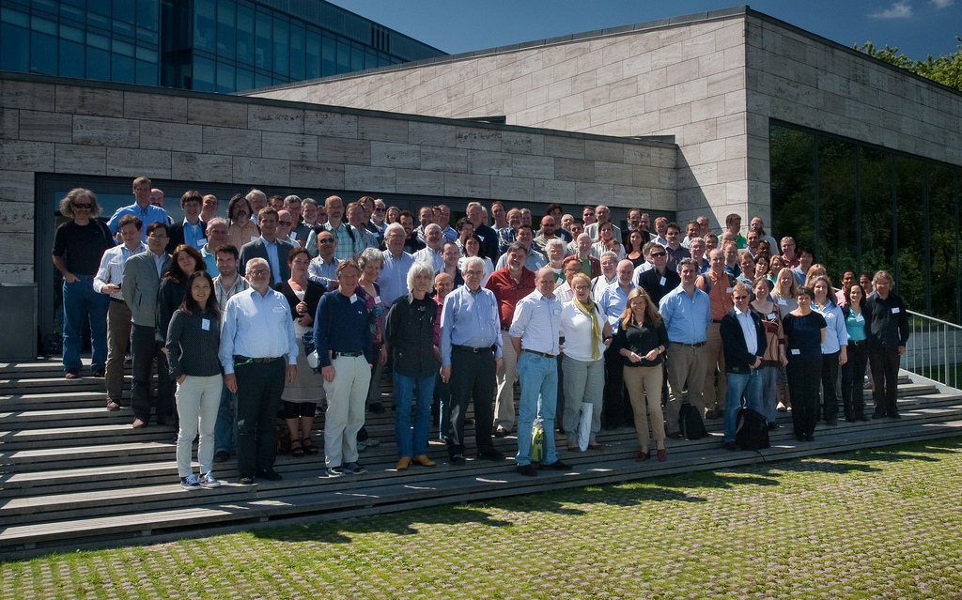
First GBIC in 2012
Copenhagen, Denmark, 2-4 July 2012
Organisers
Core team
Alberto Apostolico, College of Computing, Georgia Institute of Technology
Elizabeth Arnaud, Bioversity International
Juan Carlos Bello, Alexander von Humboldt Institute
Dora Canhos, Centro de Referencia em Informacao Ambiental (CRIA)
Gregoire Dubois, European Commission - Joint Research Centre
Dawn Field, NERC Centre for Ecology & Hydrology
Jerry Harrison, UNEP-WCMC
Bryan Heidorn, JRS Foundation & University of Arizona
Roderick Page, University of Glasgow
Cynthia Parr, Encyclopedia of Life (EOL)
Jeff Price, The Wallace Initiative and ClimaScope
Selwyn Willoughby, South African National Biodiversity Institute (SANBI)
Attendees
Around 100 participants
Geographic and thematic diversity
Informatics, science and policy roles

Slide 5
Questions from GBIC 2012 Developing a sensor network for all biodiversity
What data do we have – or could we get?
How could these data be combined?
What tools and software do we need?
What else has to change to make this possible?
How do we prioritise?
How do we know when we have what we need?
How do we present all this for funders?

Slide 6
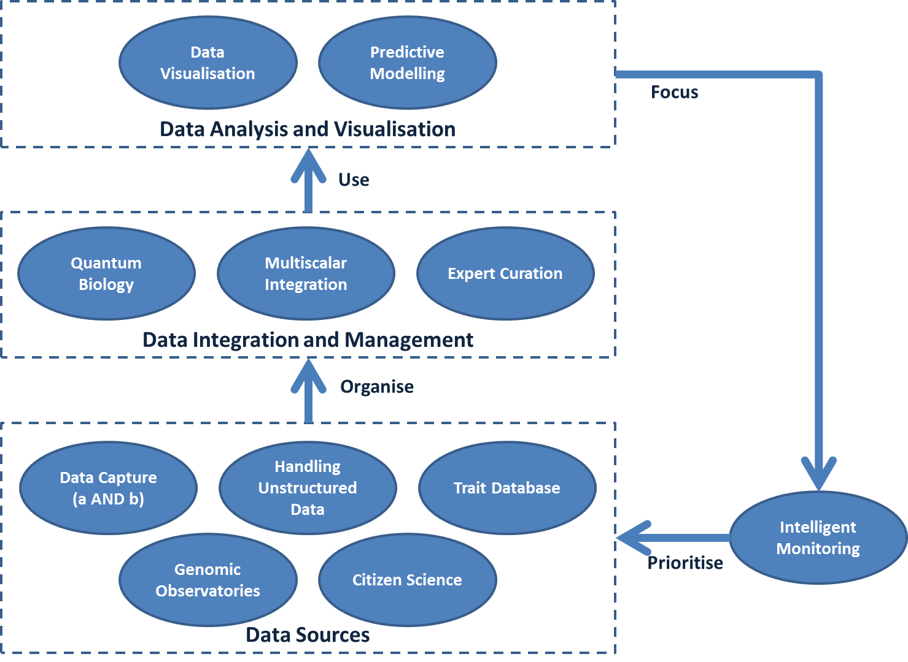
GBIC 2012 Discussions

Slide 7
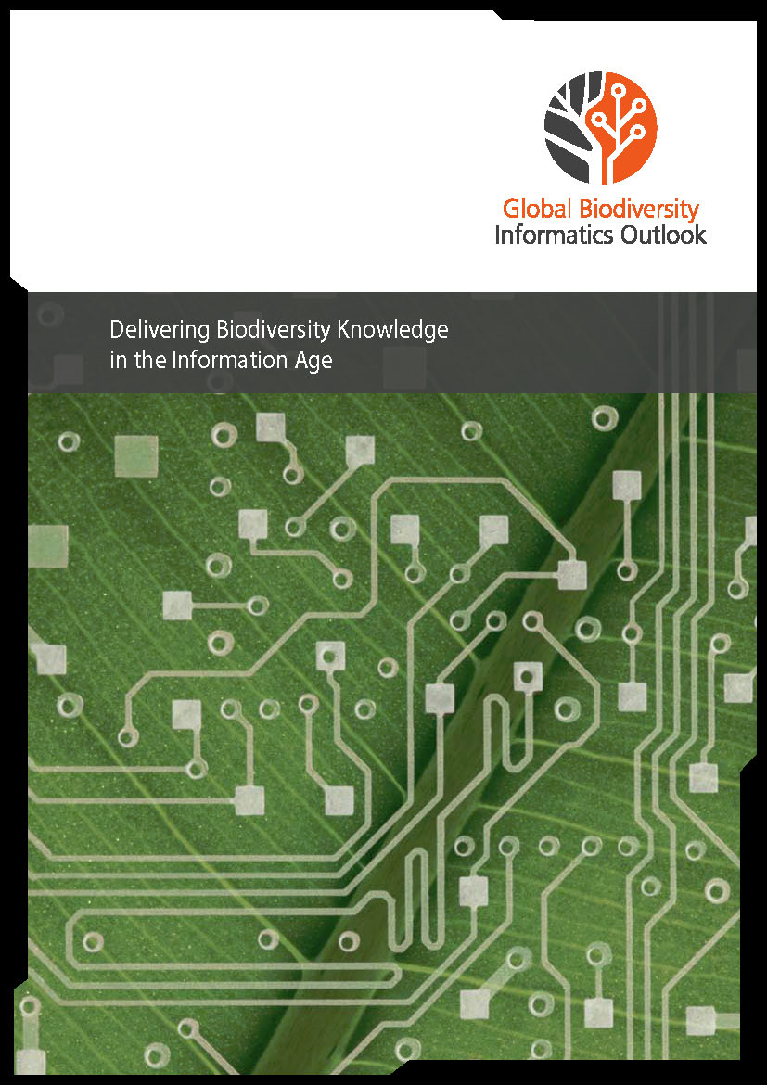
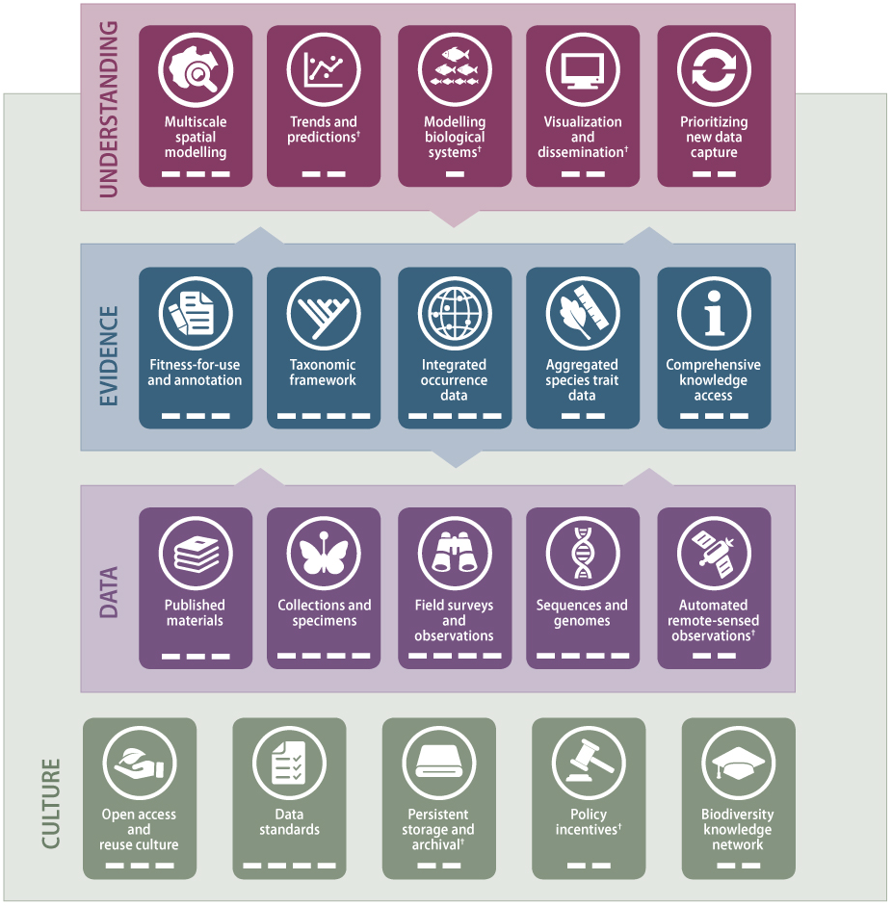
Global Biodiversity Informatics Outlook
http://biodiversityinformatics.org/

Slide 8
The GBIO Framework
Assessments and Indicators
Environmental, Climatic and Sociological Data
Understanding
Multiscale Spatial Modelling
Trends & Predictions
Modelling Biological Systems
Visualization & Dissemination
Prioritising New Data Capture
Culture
Evidence
Fitness-for-use & Annotation
Taxonomic Framework
Integrated Occurrence Data
Aggregated Species Trait Data
Comprehensive Knowledge Access
Data
Published Materials
Collections & Specimens
Field Surveys & Observations
Sequences & Genomes
Automated & Remote-sensed Observations
Open Access & Reuse Culture
Data Standards
Persistent Storage & Archival
Policy Incentives
Biodiversity Knowledge Network

Slide 9


















The GBIO Framework
Assessments and Indicators
Environmental, Climatic and Sociological Data
Understanding
Multiscale Spatial Modelling
Trends & Predictions
Modelling Biological Systems
Visualization & Dissemination
Prioritising New Data Capture
Culture
Evidence
Fitness-for-use & Annotation
Taxonomic Framework
Integrated Occurrence Data
Aggregated Species Trait Data
Comprehensive Knowledge Access
Data
Published Materials
Collections & Specimens
Field Surveys & Observations
Sequences & Genomes
Automated & Remote-sensed Observations
Open Access & Reuse Culture
Data Standards
Persistent Storage & Archival
Policy Incentives
Biodiversity Knowledge Network

Slide 10
The GBIO Framework
Assessments and Indicators
Environmental, Climatic and Sociological Data
Understanding
Multiscale Spatial Modelling
Trends & Predictions
Modelling Biological Systems
Visualization & Dissemination
Prioritising New Data Capture
Culture
Evidence
Fitness-for-use & Annotation
Taxonomic Framework
Integrated Occurrence Data
Aggregated Species Trait Data
Comprehensive Knowledge Access
Data
Published Materials
Collections & Specimens
Field Surveys & Observations
Sequences & Genomes
Automated & Remote-sensed Observations
Open Access & Reuse Culture
Data Standards
Persistent Storage & Archival
Policy Incentives
Biodiversity Knowledge Network

Slide 11




















The GBIO Component Areas
CULTURE
Open access and reuse culture
EVIDENCE
Fitness-for-use and annotation
Data standards
Taxonomic framework
Persistent storage and archives
Integrated occurrence data
Policy incentives
Aggregated species trait data
Biodiversity knowledge network
Comprehensive knowledge access
DATA
Published materials
UNDERSTANDING
Multiscale spatial modelling
Collections and specimens
Trends and predictions
Field surveys and observations
Modelling biological systems
Sequences and genomes
Visualization and dissemination
Remote-sensed observations
Prioritizing new data capture

Slide 12





Delivering a global solution
Culture: What’s Improved?
Widespread move towards open research data
Research Data Alliance
FAIR principles
Data journals
Plazi.org
Adoption of open access licenses / waivers
GBIF data now all CC0 / CC-BY / CC-BY-NC
Many other networks following similar approach
Data citation mechanisms
All GBIF datasets now associated with DOIs
Data downloads each assigned a DOI
Ability to trace back from publication to data
http://biodiversityinformatics.org/

Slide 13
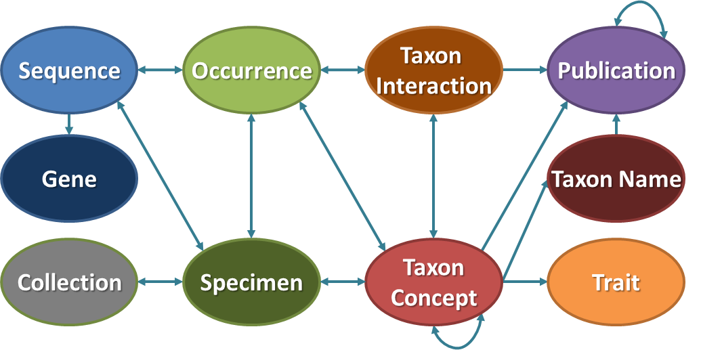

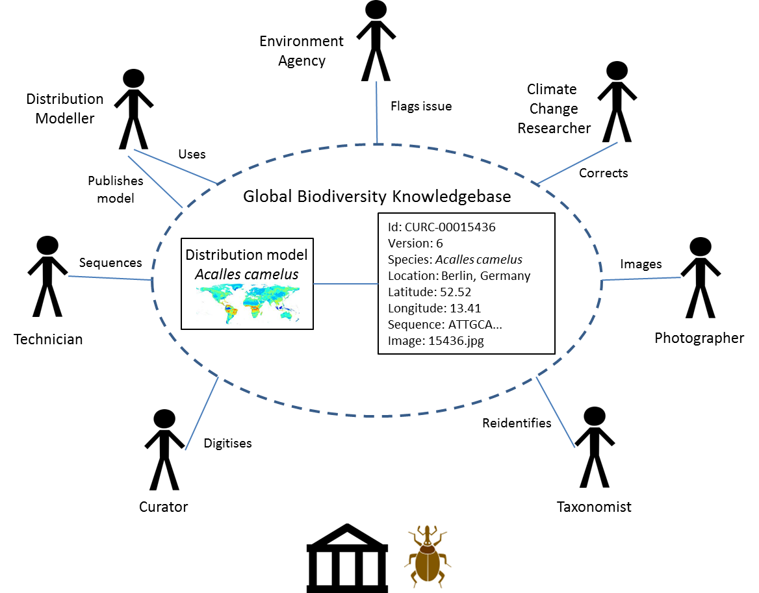
Delivering a global solution
CULTURE: What’s STILL Broken?
Data standards are largely stagnant
Existing data standards (e.g. DwC) conceal structure
No overarching meta-model for biodiversity data
Entities and concepts not easily linked
Too much data remains closed or ”unFAIR”
Research papers regularly omit associated datasets
Datasets rarely follow existing data standards
Limited progress around the ”knowledge network”
Mechanisms for expert curation weak or lacking
No coordination between research infrastructures
Unnecessary duplication of datasets
We are not yet curating a shared digital knowledgebase
http://biodiversityinformatics.org/

Slide 14

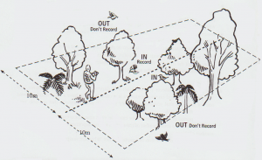
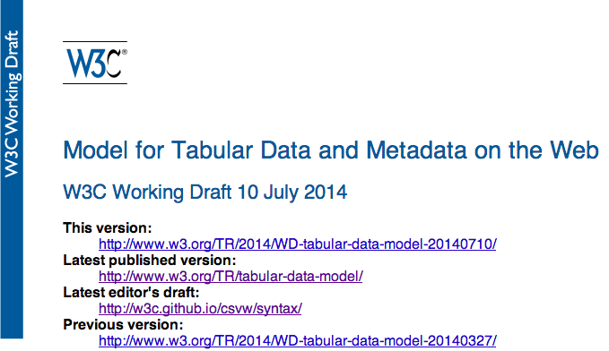
Delivering a global solution
Data: What’s Improved?
New and growing streams of digital data
Literature (especially taxonomic: BHL, Pensoft, Plazi …)
Barcode and metagenomic data
Citizen science networks
Bioacoustics, animal tracking, …
More mobilisation of ”sampling event” data
Expansion of GBIF beyond presence-only datasets
Vast opportunities around metagenomics
Promising wider scale moves for data packaging
W3C CSV on the Web
Frictionlessdata.io
http://biodiversityinformatics.org/
Transect image: http://www.wildaboutnz.co.nz/2013/04/forest-bird-slow-walk-transects/

Slide 15
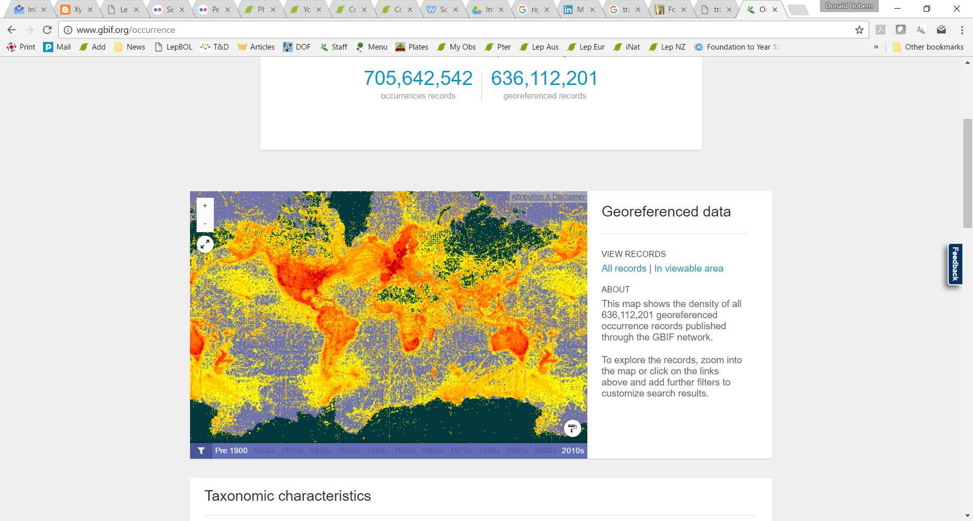


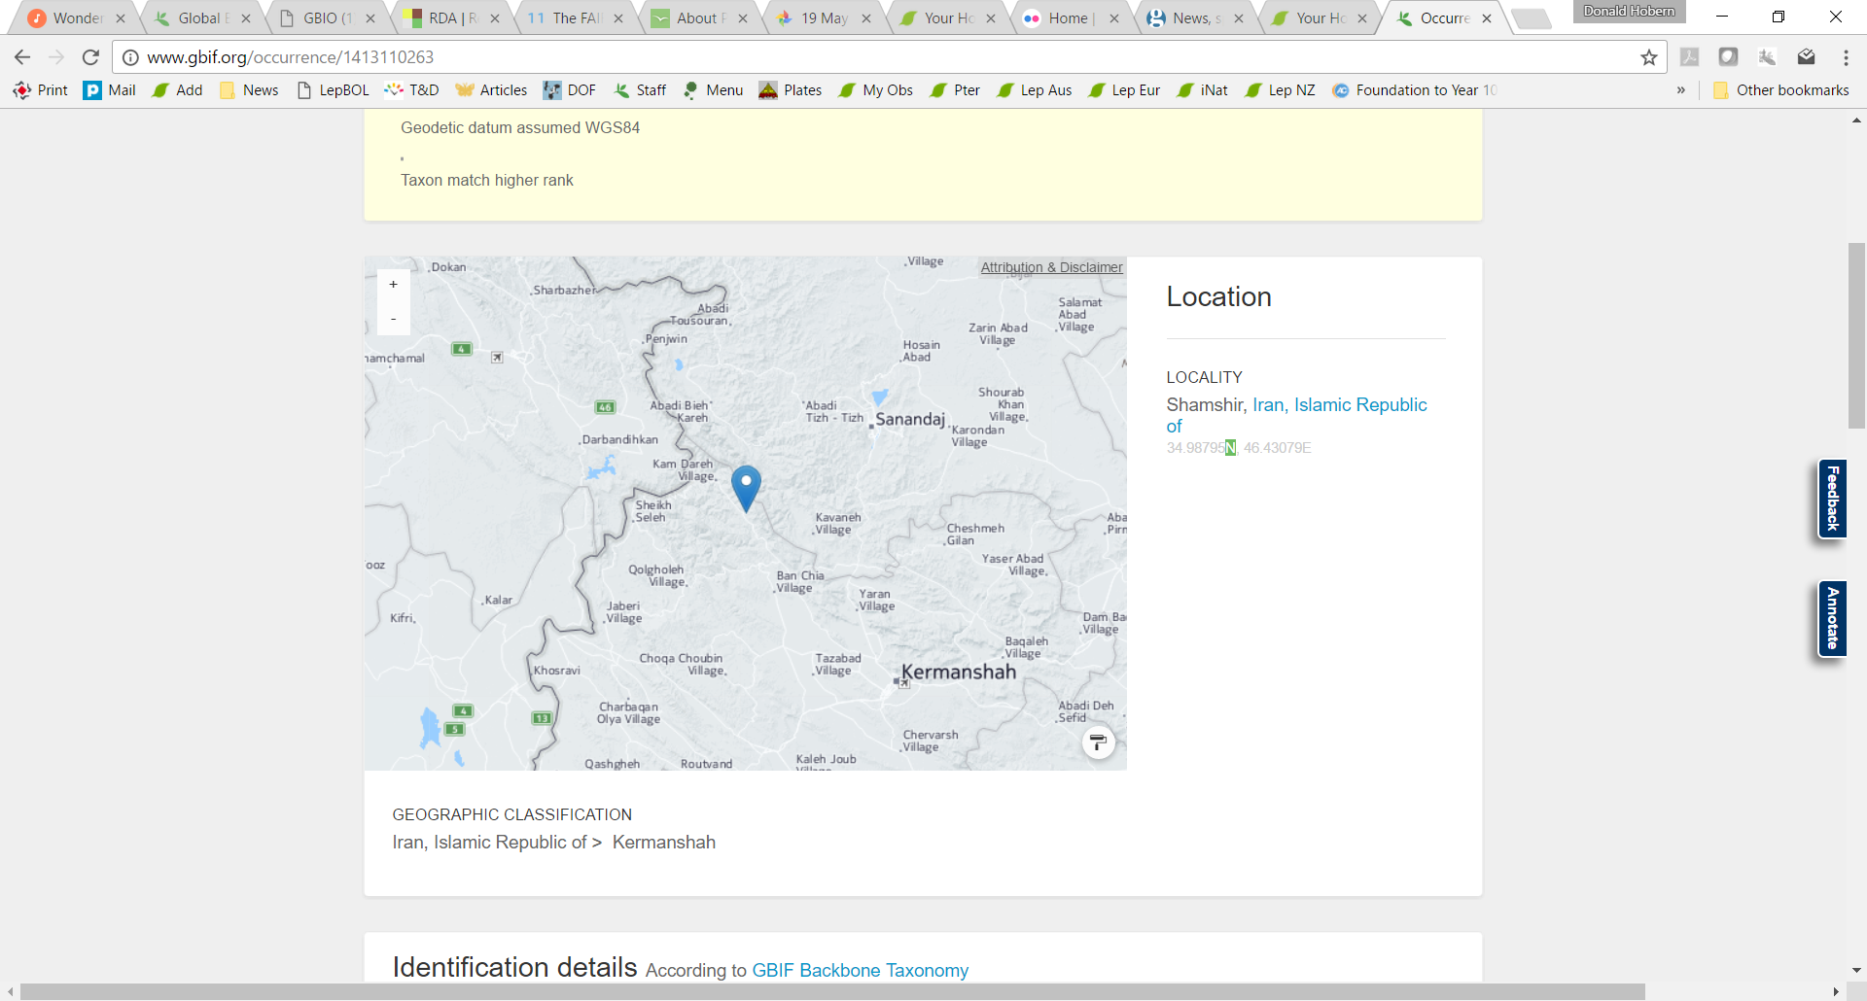
Delivering a global solution
Data: What’s STILL Broken?
Still massive gaps in accessible data
Significant variation at national / regional scale
Massive bias towards modern data for widespread birds
Massive backlog in collection digitization
Low progress with environmental impact assessment data
Molecular / non-molecular data largely disconnected
Data may be published but compatibility limited
Limited flow of molecular data today into GBIF, etc.
Need to represent molecular evidence for species
Need to handle population-level genetic variation
Digitisation limited to basic specimen (meta-)data
Not approaching a ”global virtual natural history collection”
Limited mobilisation of specimen images, sequences
No consistent models for taxon-specific morphometric data
http://biodiversityinformatics.org/

Slide 16
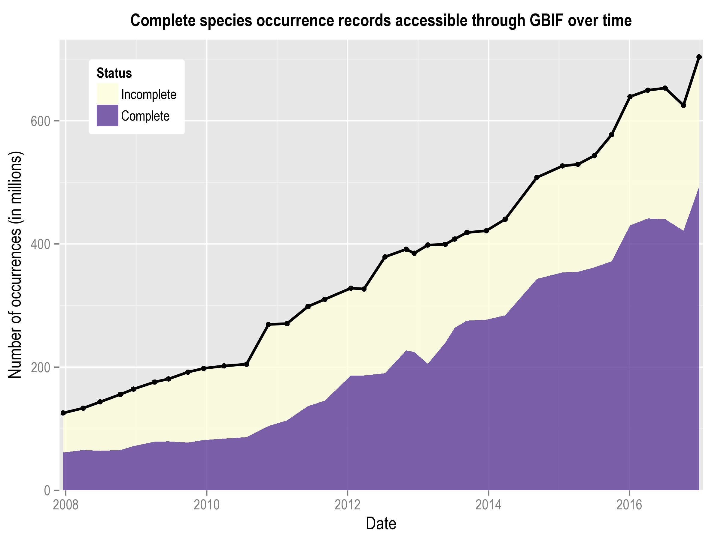
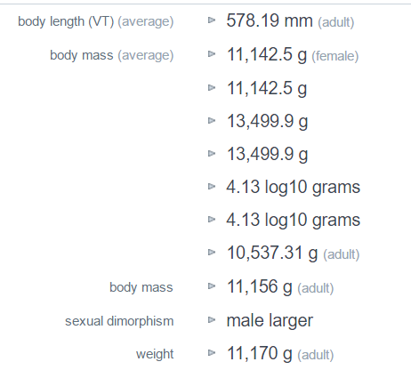
Delivering a global solution
Evidence: What’s Improved?
Continued growth in integrated data
More than a billion occurrence records in GBIF
Improved scaling in processing and data cleaning
Progress in organising species-level data
EOL TraitBank
Global Biotic Interactions (GloBI)
Global Register of Introduced and Invasive Species (GRIIS)
Plazi TreatmentBank
http://biodiversityinformatics.org/
Traits for Brachyteles arachnoides: http://eol.org/pages/323939/data

Slide 17


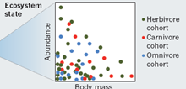
Delivering a global solution
Evidence: What’s STILL Broken?
STILL no comprehensive digital taxonomic framework
Incomplete nomenclatural datasets
Incomplete Catalogue of Life
No effective crosslinking of informal taxon concepts
Limited cross-linkage to phylogeny
Weak / non-existent mechanisms for data curation
No stable LOD (linked open data) foundations
Significant heterogeneity in tools and platforms
Limited predictability around key trait information
Need more focus on individual measurements / sequences
Need more focus on populating key traits in consistent way
http://biodiversityinformatics.org/

Slide 18
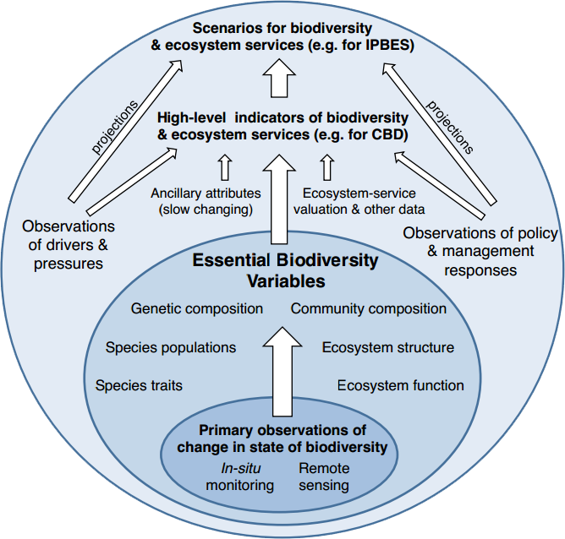
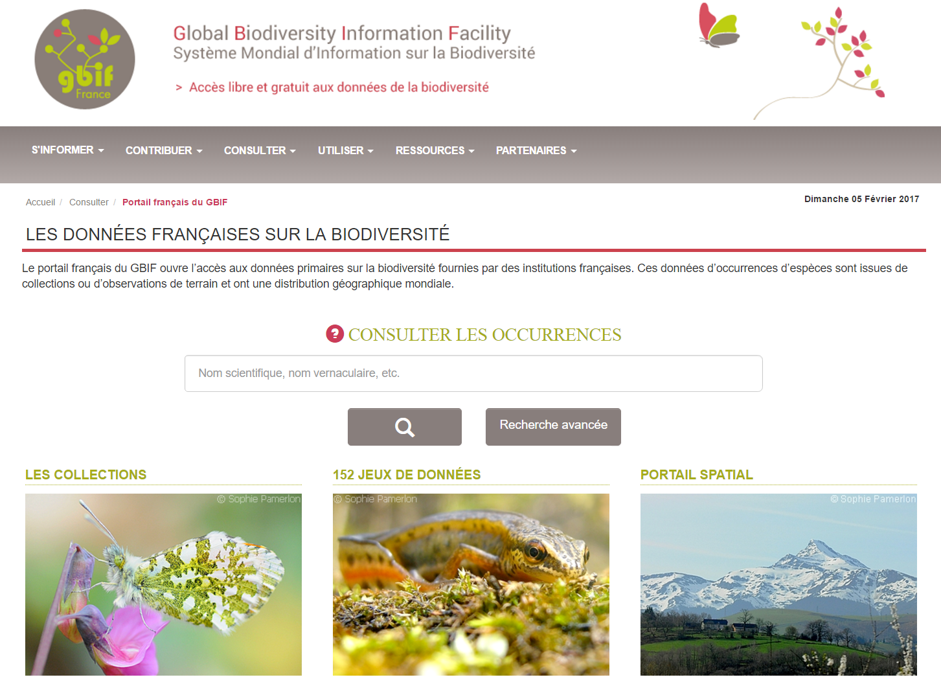
Delivering a global solution
Understanding: What’s Improved?
Focus on Essential Biodiversity Variables
Attention to standardizing key aspects of biodiversity
Potential reduction in model complexity
Opportunities for standardized data management
Measured variables and modeled interpolations
Growing focus on species occupancy as EBV
Increased deployment of (national) integrative portals
Opportunities to align data with analysis and use
Focused integration with national environmental, taxonomic and other data sets
Hubs for national-scale collaboration
http://biodiversityinformatics.org/

Slide 19
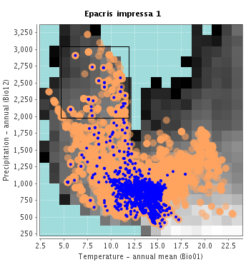
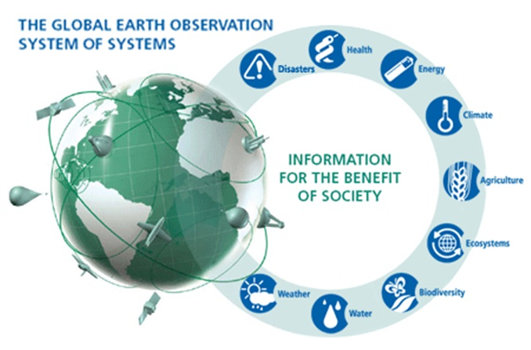
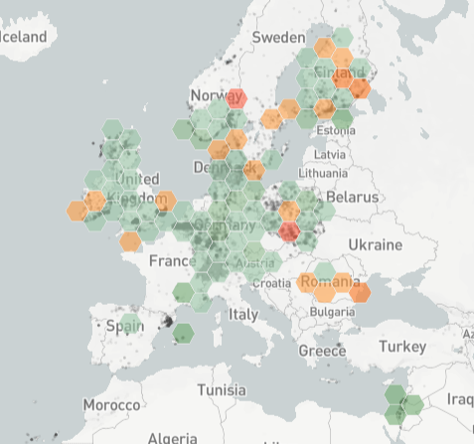
Delivering a global solution
Understanding: What’s STILL Broken?
Need flexible tools for combining classes of data
Link distribution, biology, molecular, environment, …
Support large scale data cubes
Semantic mining
Slow progress in EBV implementation
Need plan for delivering some key EBV datasets
Nothing delivered e.g. at level of GEOSS
Need large-scale prototyping
Limited understanding of effect of data gaps
Which gaps matter?
How well can we characterise biodiversity from available data?
Prioritise data capture to maximise information
http://biodiversityinformatics.org/

Slide 20

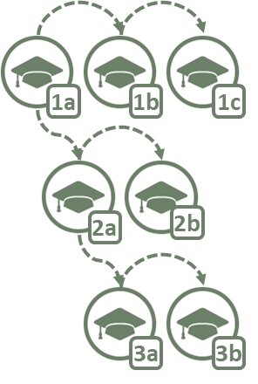
GBIC2: Coordinating Joint Planning
Coordination
Team
Coordinates
Consultation Process
Expert
Group
Draft
Roadmap
Wide
Consultation
Agreed
Roadmap
Governance
Technical Support
Communication
Coordinating Mechanism
Funding and Sustainability
Best Practices

Slide 21
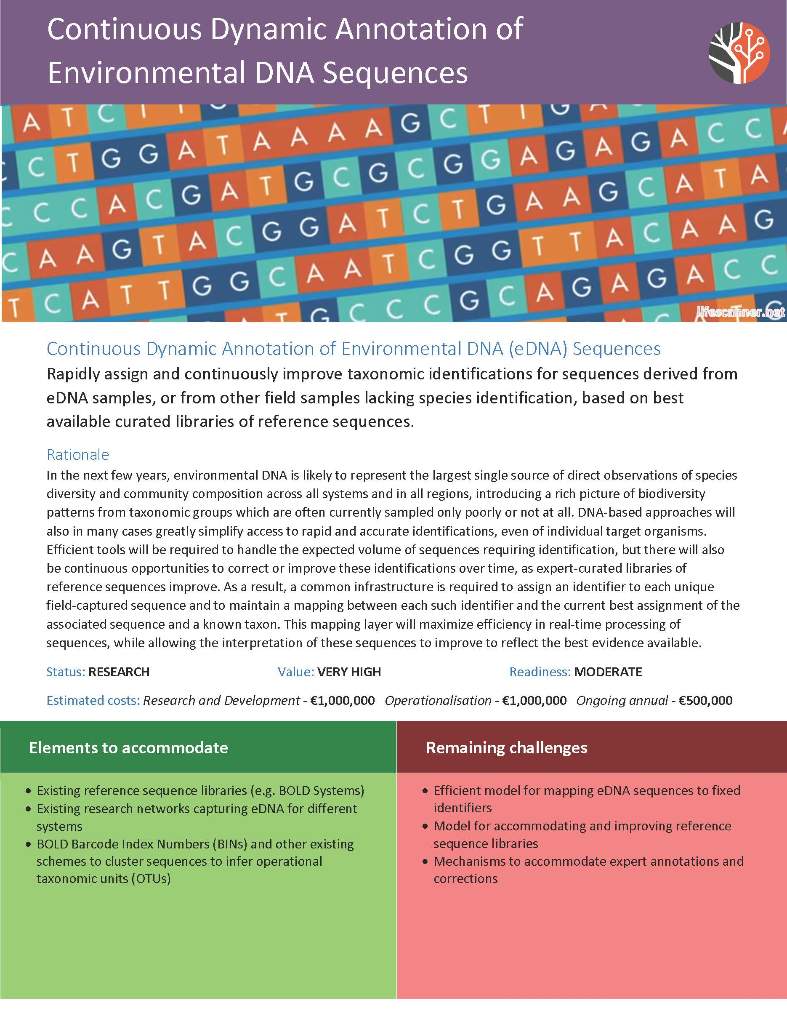
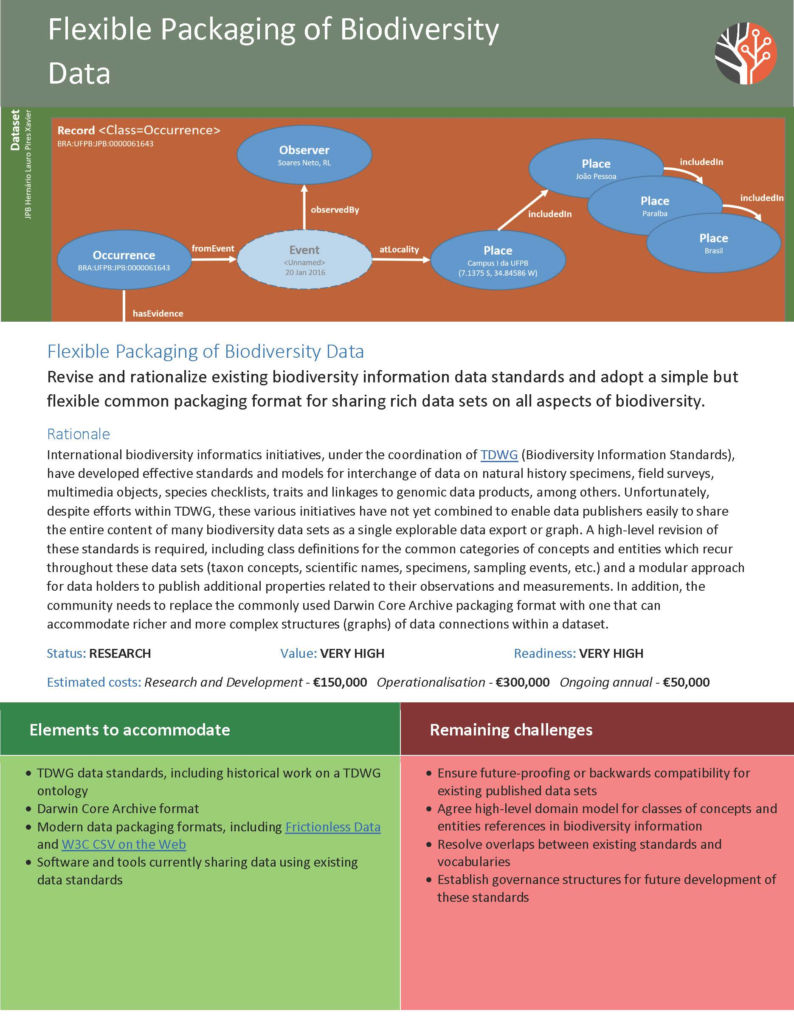
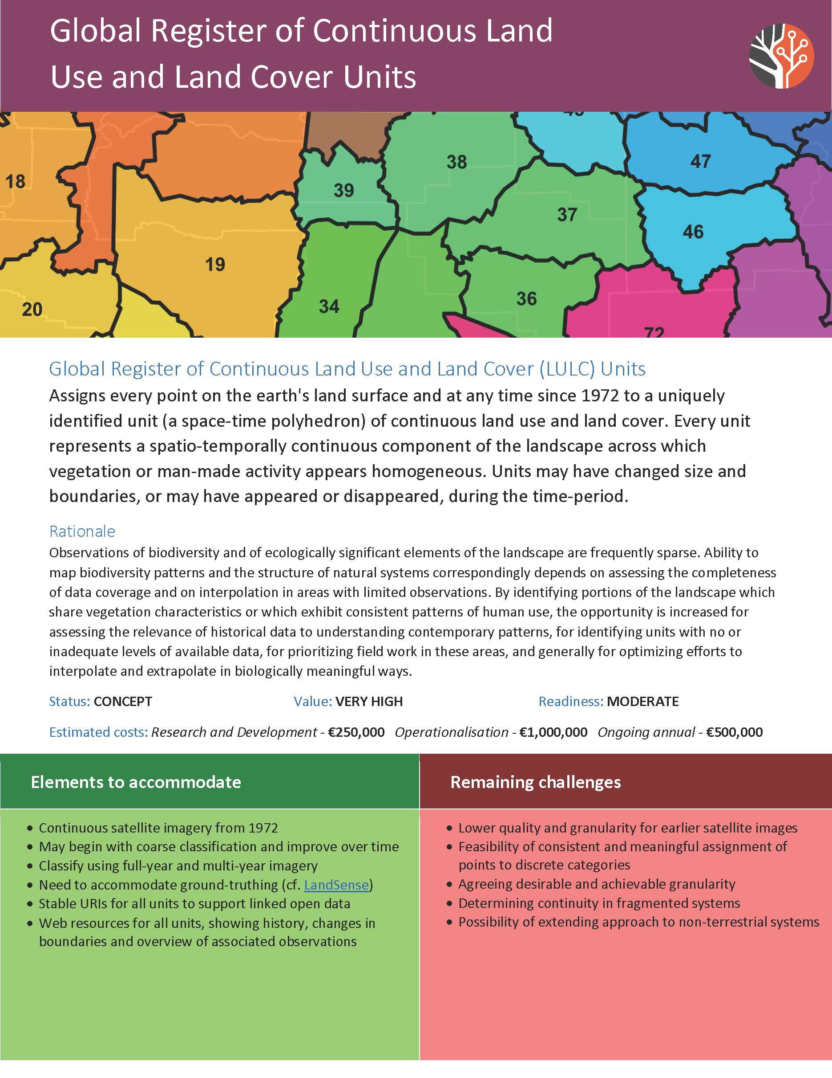
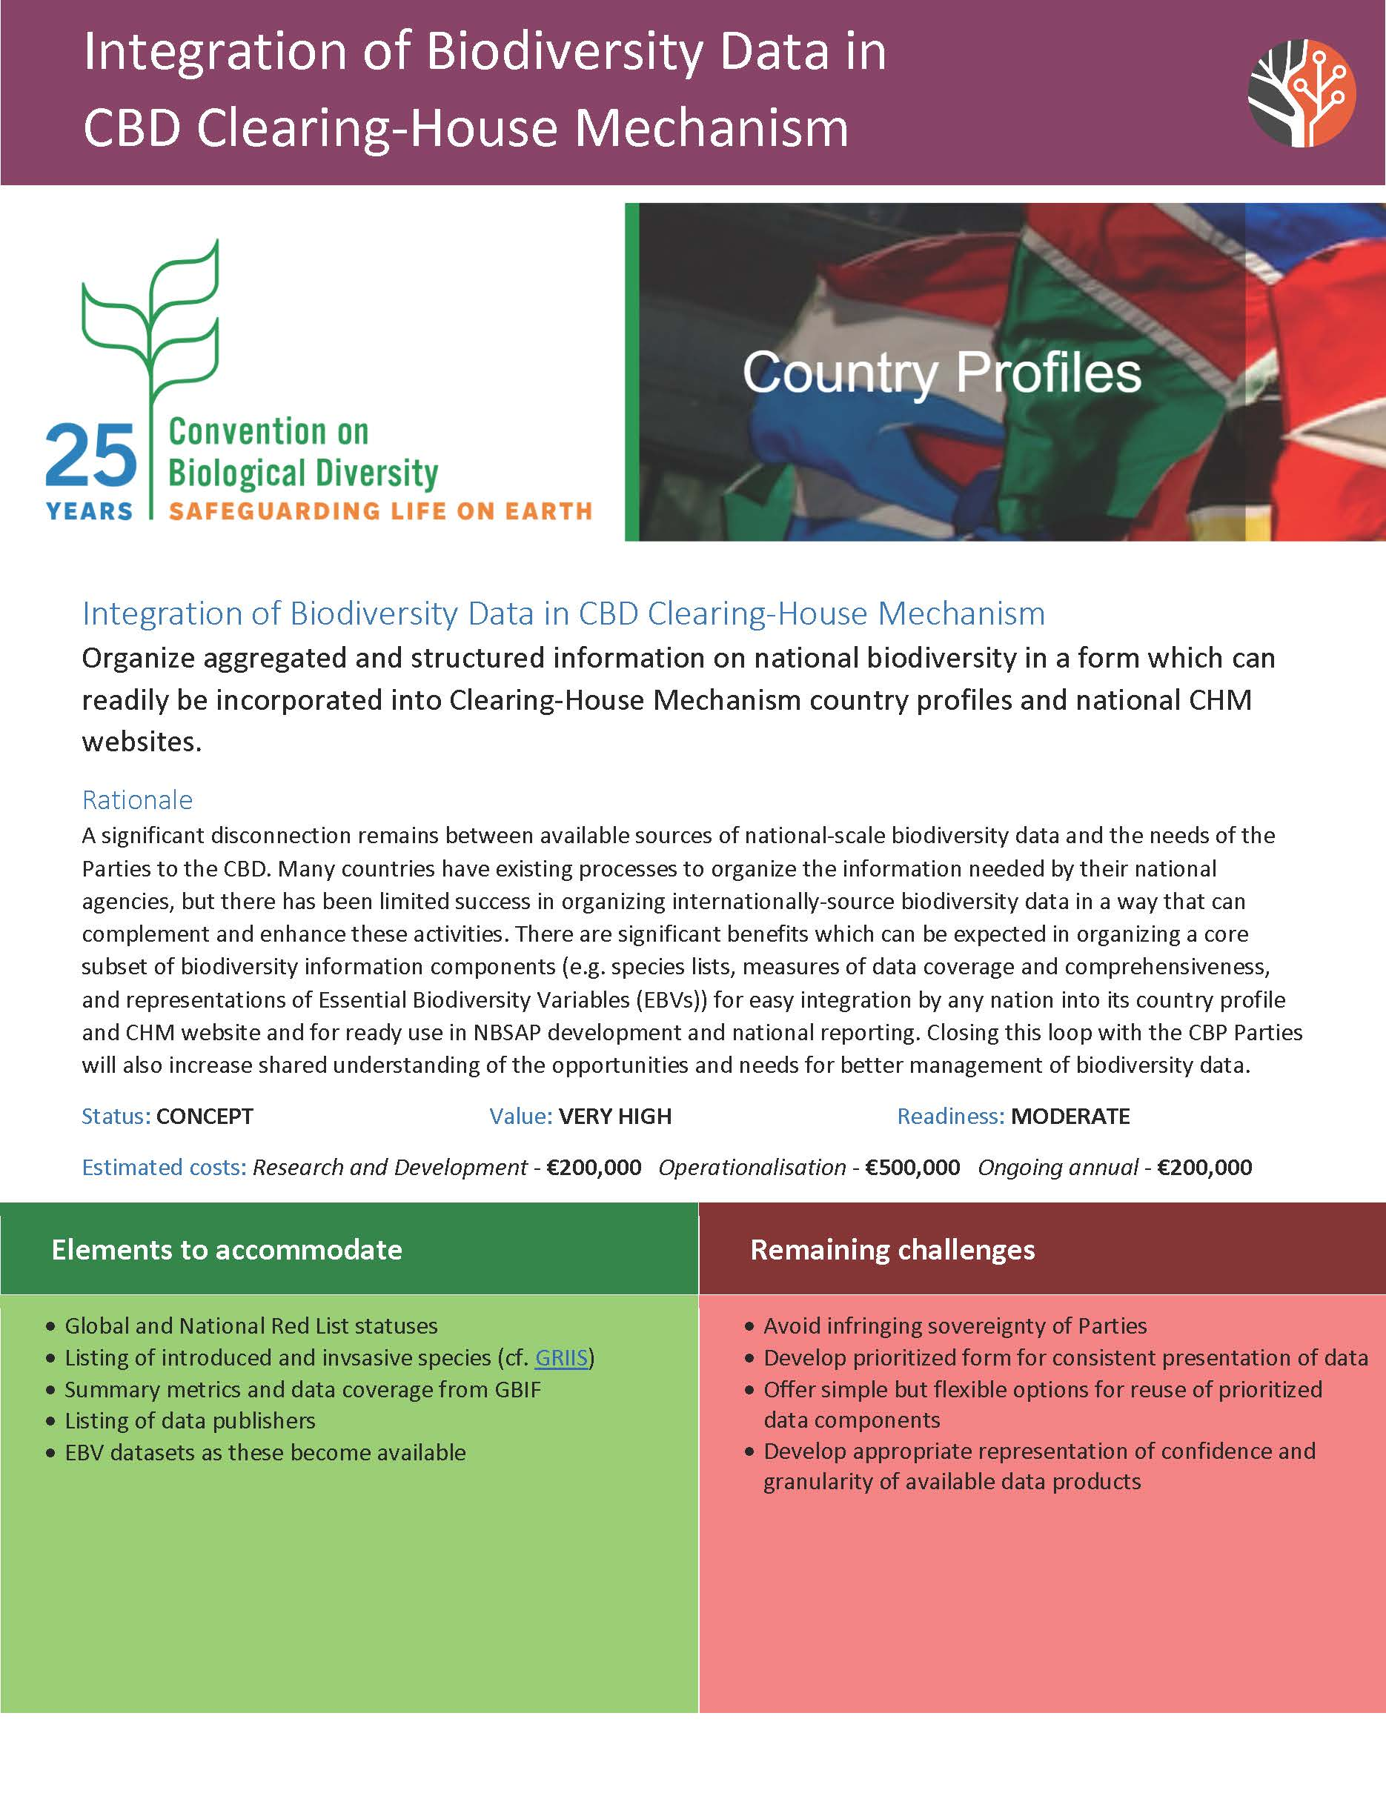
Investment priorities

Slide 22
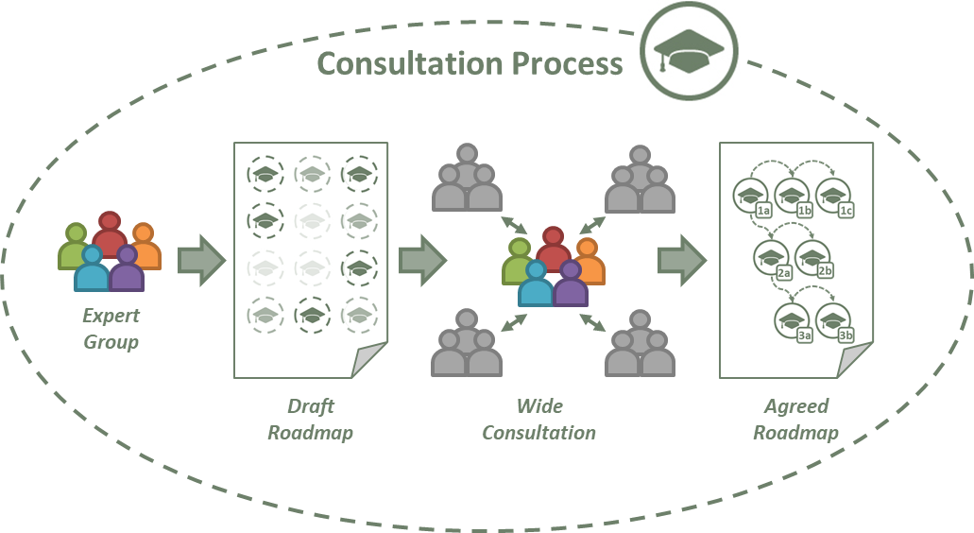
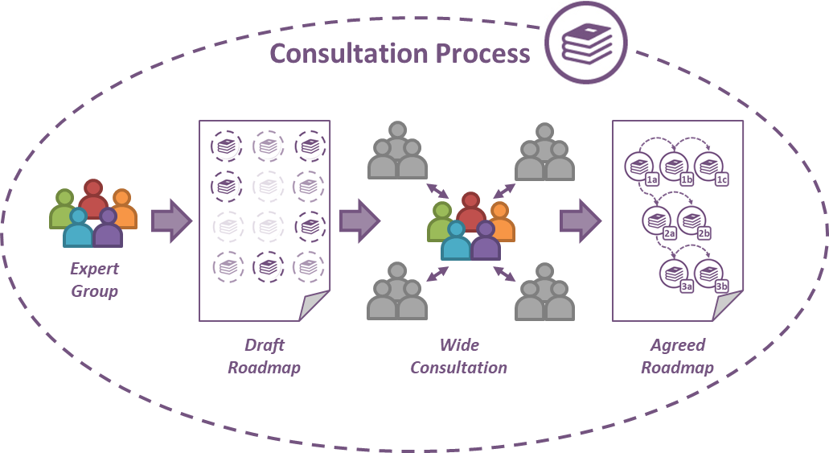
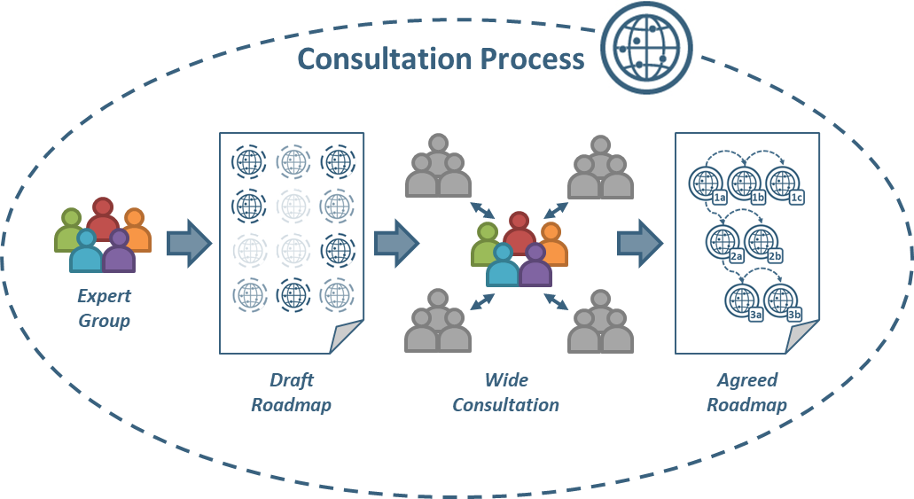
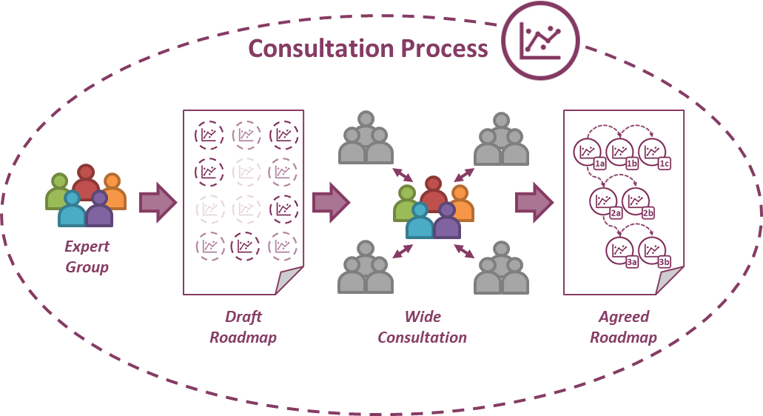
GBIC2: Coordinating GBIO Implementation
Coordination
Team
Governance
Technical Support
Communication
Coordinating Mechanism
Funding and Sustainability
Best Practices

Slide 23
















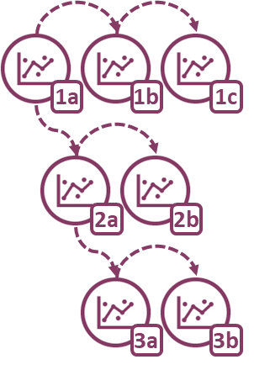
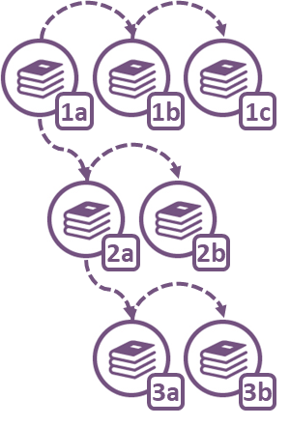
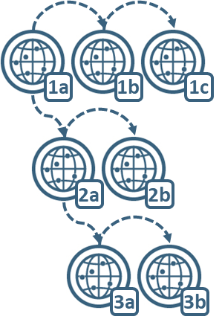







GBIC2: Coordinating JOINT Implementation
€
₽
€
₽
₽
¥
Communicateand Translate Roadmaps
Advise on Standards and Best Practice
Support Proposal Development
Coordinate Letters of Support
¥
¥
Government
Agency
Yes!
是!
£
Coordinates
Professional
Society
¥
Natural
History
Collection
Coordination
Team
Networks and
Consortia
$
$
Computing
Centre
$
$
University
$
$
€
£
€
€
$
Agreed Roadmaps
£
£
Industry
$
Translation icon: Mgalloway / CC-BY-SA-3.0 - Bullet list icon: Chameleon Design, IN / CC-BY-3.0

Slide 24
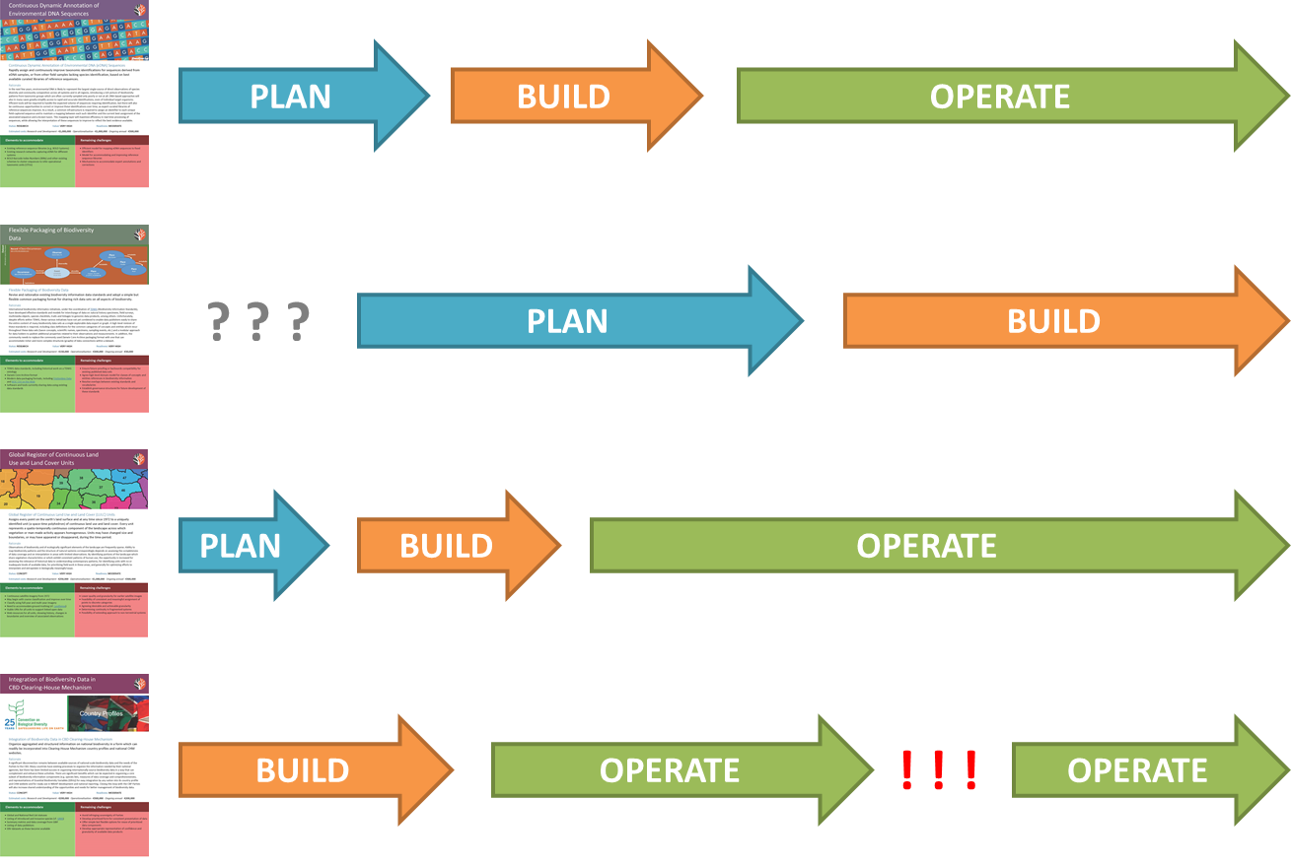
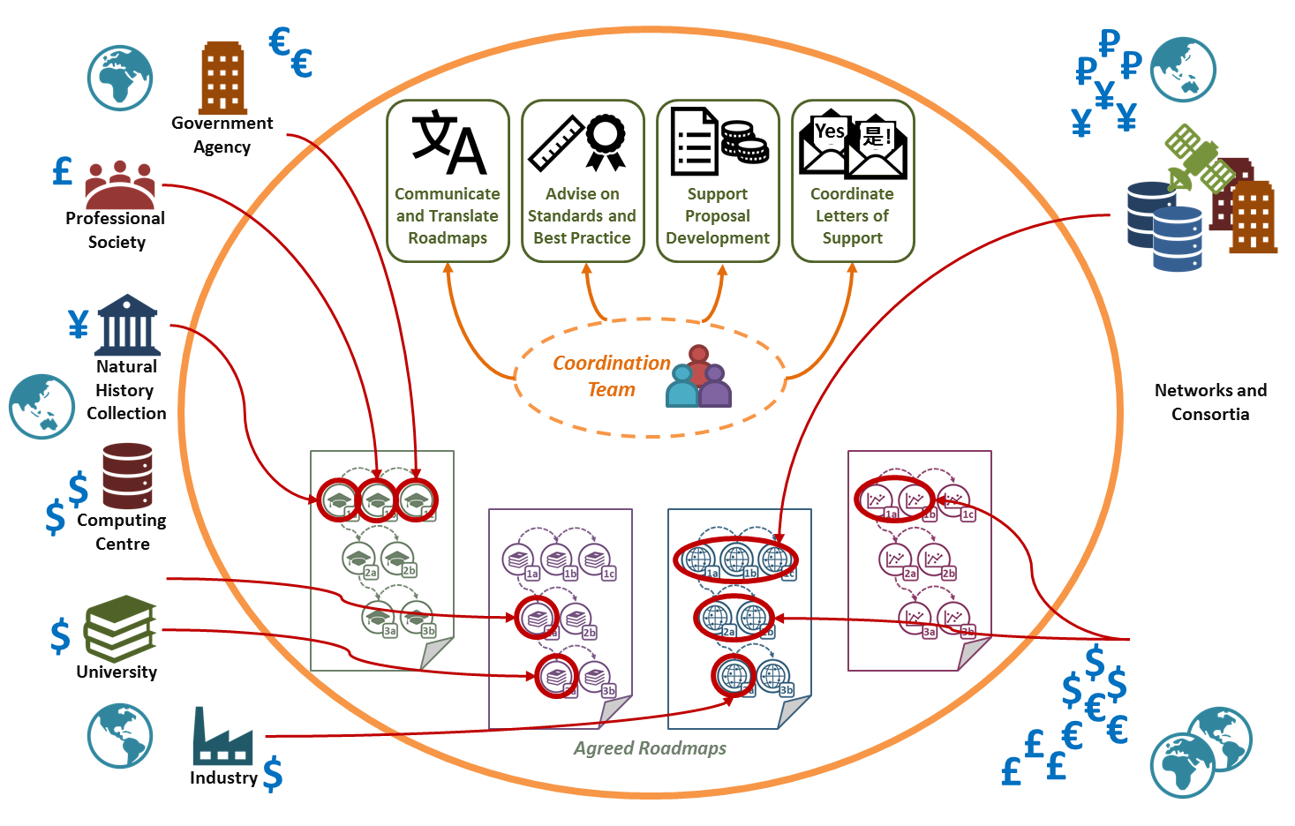
How MUCH COORDINATION IS POSSIBLE?
EASIER
HARDER
Shared vision
Shared language
Shared vision
Shared language
Shared priorities
Shared vision
Shared language
Shared priorities
Shared reporting
Shared vision
Shared language
Shared priorities
Shared reporting
Shared funding
Shared delivery
Shared sustainability

Slide 25
What happens after this week?
Consultation Paper summarising outcomes
Consensus from attendees
Dissenting perspectives
Open questions
Multiple language versions
International consultation on suggested model
Expand buy-in from a broader community
Refine ideas where appropriate
Secure funding to begin implementation
Details depend on adopted model

Slide 26
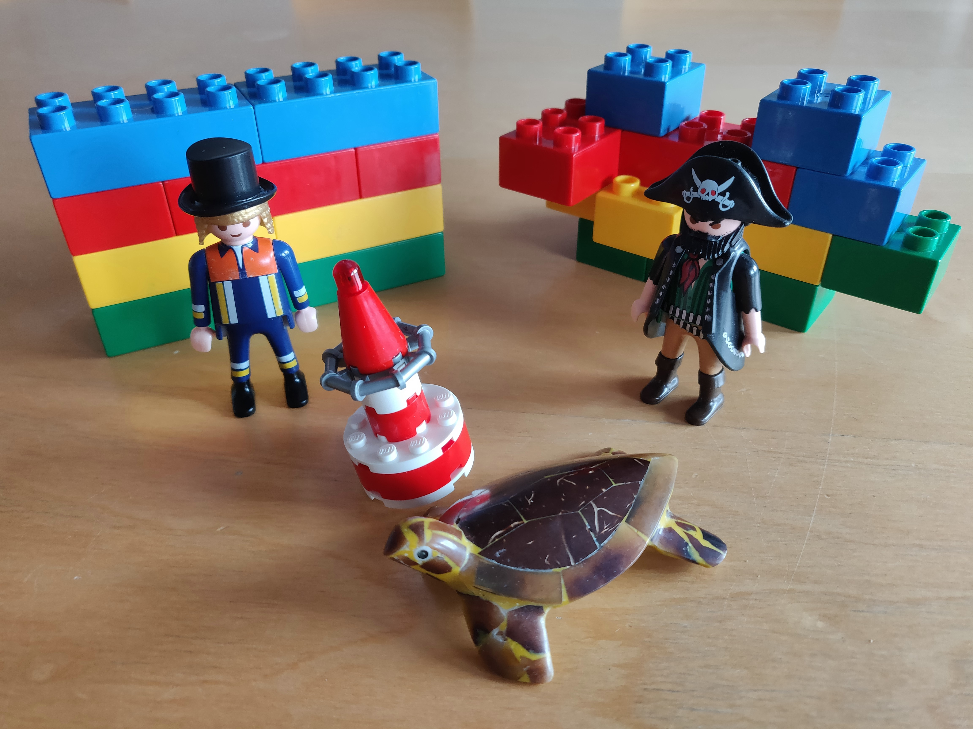

Facilitated Plenary sessions

Slide 27
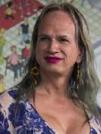
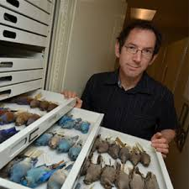
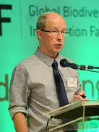
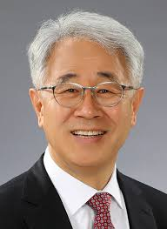

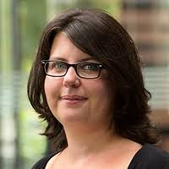
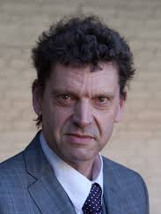
Steering Committee
Brigitte Baptiste
Alexander von Humboldt Institute
Colombia
Rob Guralnick
Florida Museum of Natural History
USA
Donald Hobern
GBIF Secretariat
Denmark
Eun‐Shik Kim
Kookmin University
Korea
Isayvani Naicker
African Academy of Science
Kenya
Laetitia Navarro
German Centre for Integrative
Biodiversity Research (iDiv)
Germany
Edwin van Huis
Naturalis
Netherlands

Slide 28
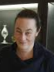

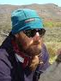
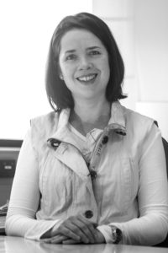


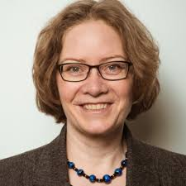
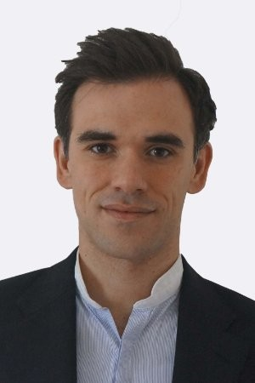
Session Facilitators
Michelle Price
Conservatoire et Jardins Botaniques
de Ville de Genève
Switzerland
Carolyn Sheffield
Smithsonian Libraries
USA
John Wieczorek
University of California, Berkeley
USA
Melodie McGeoch
Monash University
Australia
Dmitry Schigel
GBIF Secretariat
Denmark
Daniel Noesgaard
GBIF Secretariat
Denmark
Andrea Hahn
GBIF Secretariat
Denmark
Andrew Rodrigues
GBIF Secretariat
Denmark

Slide 29













SPONSORS

Slide 30
How Closely can we COORDINATE WORK?
PLAN
BUILD
OPERATE
? ? ?
PLAN
BUILD
PLAN
BUILD
OPERATE
BUILD
OPERATE
! ! !
OPERATE

Slide 31

Thank you
Donald Hobern
GBIF Executive Secretary
dhobern@gbif.org
Notes:
GBIF exists to facilitate free and open access to biodiversity data in support of science and, through science, of science-based policy. The original OECD proposal for GBIF included an expansive vision for biodiversity content, including many areas which are now the domain of other international biodiversity informatics activities, including the Catalogue of Life, the Encyclopedia of Life, the Biodiversity Heritage Library and others.
GBIF itself serves as the global aggregation point for primary data on the occurrence of species, deriving mainly from natural history specimens and field observations. These data remain under the control of data publishing institutions located around the world. GBIF’s central services enable the data to be brought together and organised consistently to support user searches and downloads and to deliver basic GIS capability. Increasing numbers of peer-reviewed articles document research based on GBIF-mediated data.
GBIF has demonstrated the capability and effectiveness of its global network and of these data integration tools. Focus is now turning to improved understanding of the coverage and gaps in available data and to prioritising delivery of key data sets of high value to research. These priorities will include incorporating more detail on the sampling events from which many data records derive and on the representation of species abundance. GBIF will also work more closely with other biodiversity informatics activities to improve the interoperability between species occurrence data and other classes of biodiversity data.

Slide 32


COORDINATION REQUIREMENTS
Coordinate roadmap consultations
Coordinate selection of experts
Facilitate expert workshops
Consult on recommendations
Coordinate final revisions
Support proposal development
Guide stakeholders on roadmap requirements
Broker linkages between projects
Maintain overview of unmet needs
Communicate and translate roadmaps
Publish final consensus roadmap
Coordinate translations of roadmap
Publicise roadmap internationally
Coordinate letters of support
Coordinate support from other international stakeholders
Explain value proposition for roadmap components
Yes!
是!
Advise on standards and best practices
Coordinate with standards bodies
Maintain references to standards
Advise stakeholders how to align activity
Monitor and assure sustainability
Monitor status of developed components
Facilitate transfer of responsibility where necessary

Slide 33
ExAMPLE GBIO Component AreaS in GBIC2
CULTURE
Open access and reuse culture
EVIDENCE
Fitness-for-use and annotation
Data standards
Taxonomic framework
Persistent storage and archives
Integrated occurrence data
Policy incentives
Aggregated species trait data
Biodiversity knowledge network
Comprehensive knowledge access
DATA
Published materials
UNDERSTANDING
Multiscale spatial modelling
Collections and specimens
Trends and predictions
Field surveys and observations
Modelling biological systems
Sequences and genomes
Visualization and dissemination
Remote-sensed observations
Prioritizing new data capture

Slide 34
GBIC2: Component Roadmaps
A
C
B
Define deliverables to be achieved
Identify known challenges and issues
Document existing standards and best practices
Identify existing infrastructures or tools for adoption/support/enhancement as components
Identify and describe missing components and required services
Identify dependencies or overlaps with other GBIO component areas

Slide 35
GBIC2: Funding Roadmap Implementation
International institutions and projects
Identify potential funding sources
Develop funding proposals to implement components
Plan sustainable delivery and long-term collaboration
Roadmap project office
Offer guidance on alignment with international plans
Coordinate letters of support from global community
International partners
Provide requirements / advice / implementation support
Align activities with funded components

Slide 36
GBIC2: Fundamental Requirements
Transparency and clear governance
Open international collaboration
Mechanisms to support trust between stakeholders
Commitment to open access data culture
Development of a common conceptual outline
Credibility with governments and funding bodies
Credibility with researchers and scientific bodies

Slide 37
GBIC2: Issues to solve
Existing funding short-term project-based
Overlapping stakeholder mandates
Existing project timelines and milestones
Sustainability of components
Low levels of trust from researchers for “aggregators”
Handling competitive attempts to implement components
Limited engagement with some geographic regions
Challenges of multilingual collaboration

Slide 38
Fundamental underpinnings of biodiversity science | Measuring and observing biodiversity | Monitoring biodiversity | Understanding drivers of biodiversity | Modelling and predicting changes in biodiversity | Valuing biodiversity
Characterising species
Cataloguing
biological
material
Assessing data fitness-for-use for monitoring
Understanding role of climate/ environment
Supporting species identifications
Monitoring range changes
Assessing impacts from invasive species
Developing predictive models
Supporting access and benefit sharing
Recording species distributions
Classifying
biodiversity
Monitoring community changes
Assessing effects of changed land-use
Recording species abundance
Monitoring genetic changes
Assessing effects of connectivity
Identifying critical thresholds
Assessing economic value
Categorising ecological communities
Categorising natural environments
Documenting species invasions
Assessing effects of exploitation
Characterising genera of benefit to man
Notes:
The Strategic Plan 2012-2016 identifies three strategic imperatives. These are all interconnected and cannot be separated.

